Slide 1

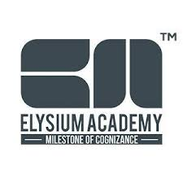
Cross-Disciplinary AI Applications
Integrating AI Across Multiple Fields of Study
Week 4: Application and Integration | 1.5 Hour Session

Slide 2

What You'll Master Today
Develop Interdisciplinary AI Applications
Create Collaborative AI Workflows
Build AI solutions that bridge multiple academic fields and solve complex real-world problems
Design efficient processes using multiple AI tools working together seamlessly
Connect Insights Across Fields
Build Your Personal AI Toolkit
Use AI to discover unexpected connections between different disciplines and perspectives
Curate the right AI tools and techniques for your unique academic journey

Slide 3
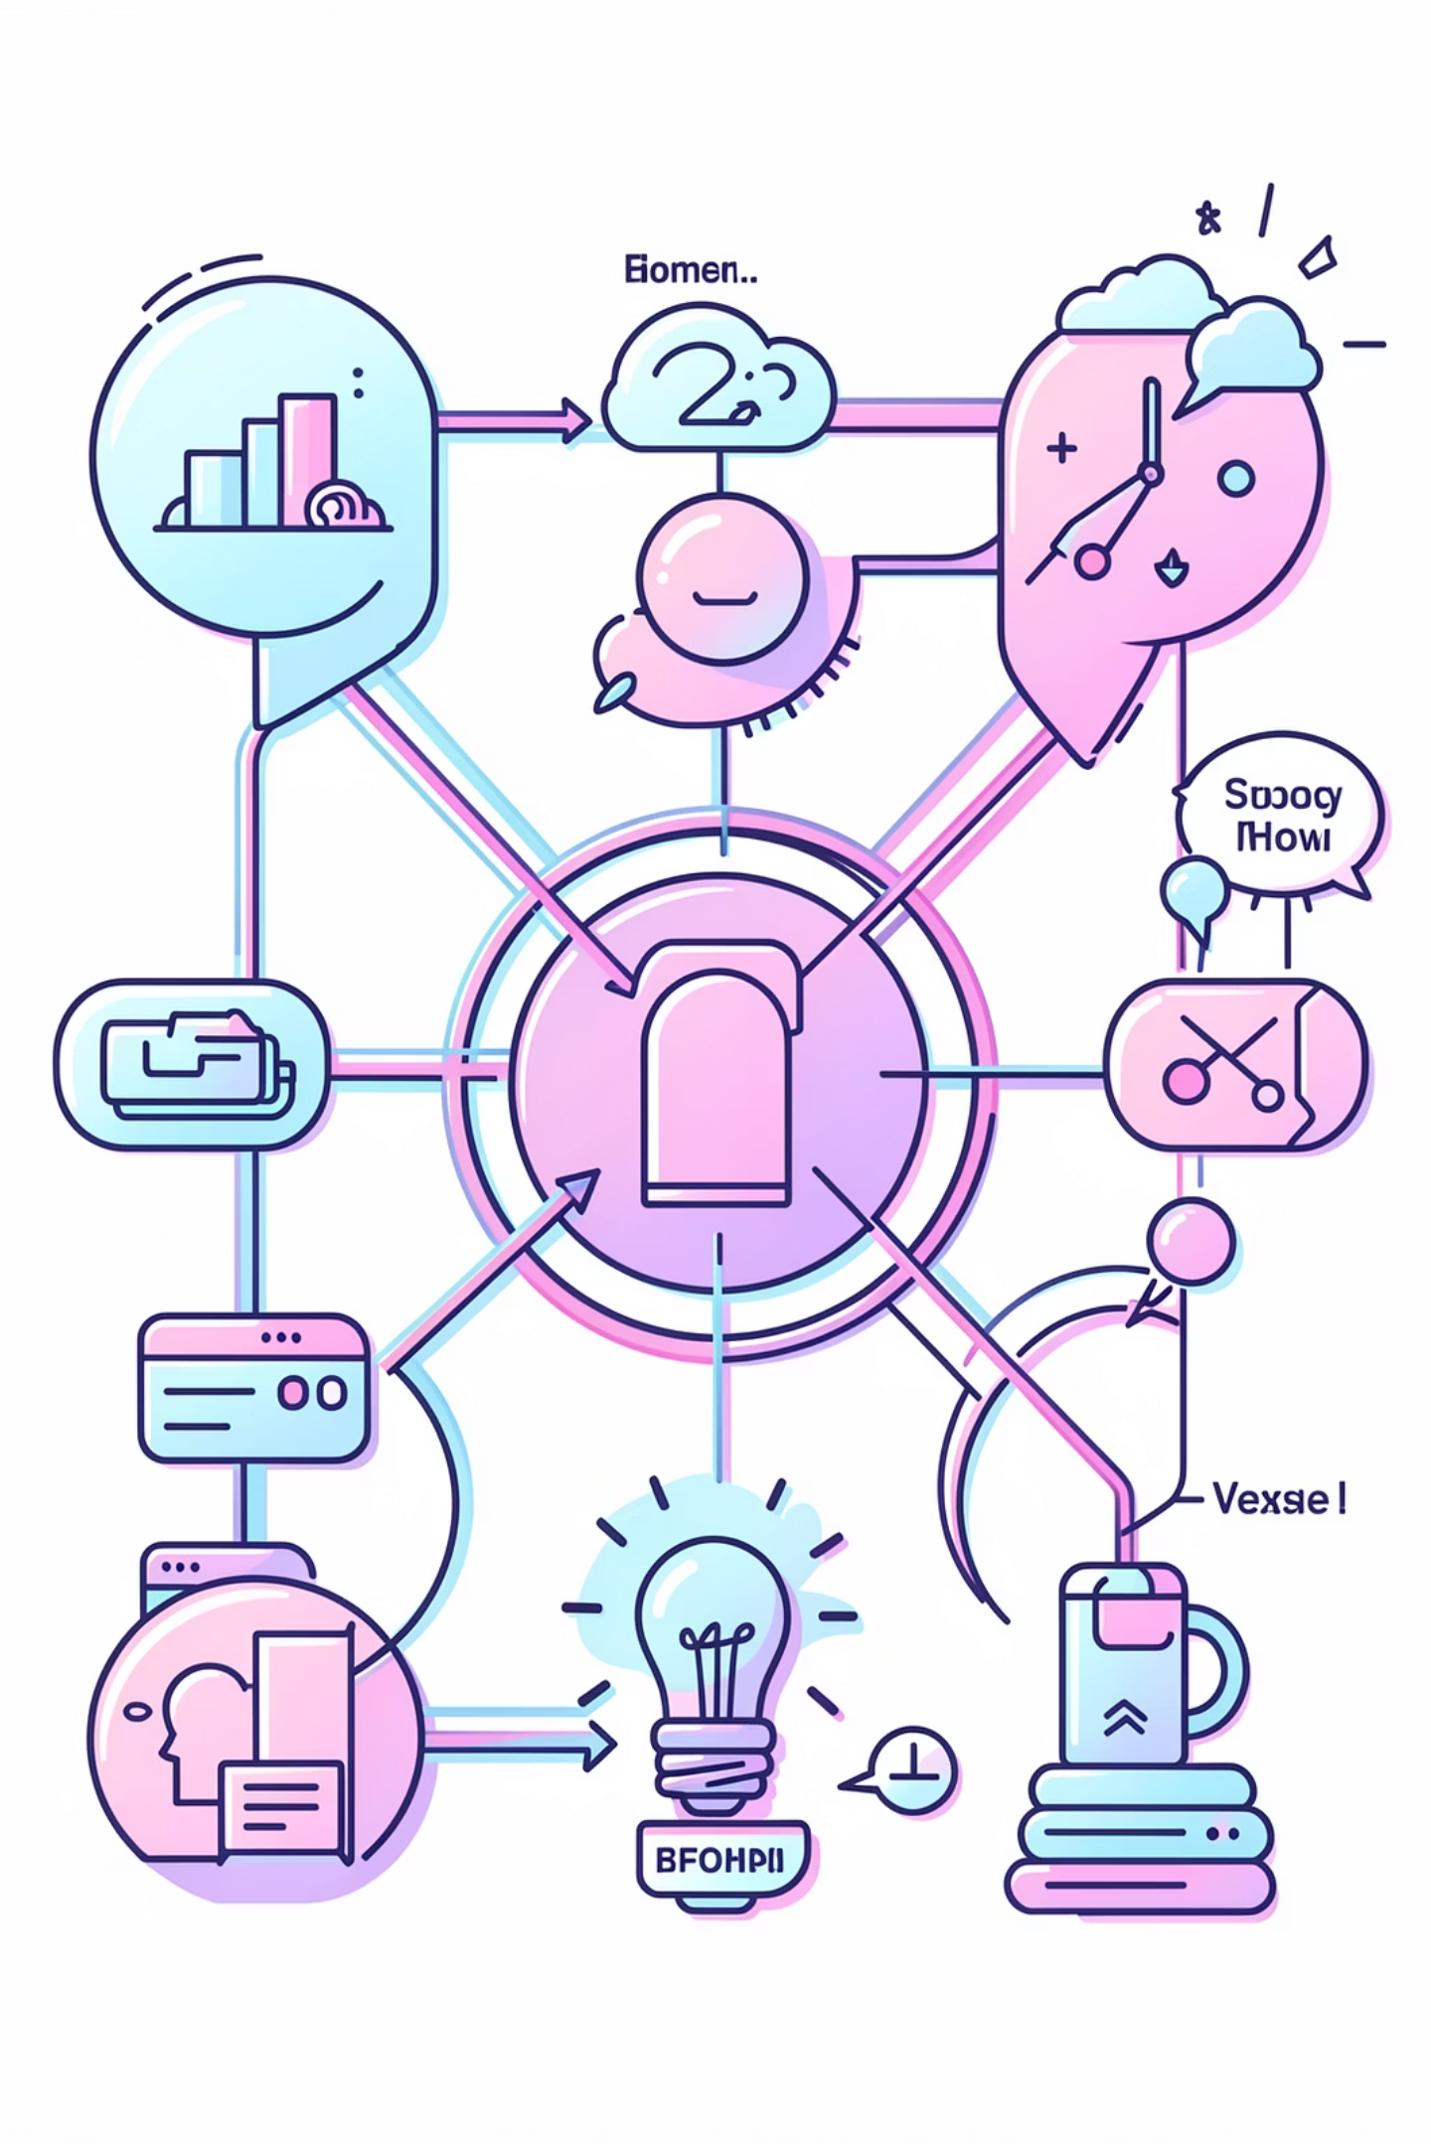
Why Interdisciplinary Thinking Matters
Real-world problems rarely fit neatly into one discipline. Modern challenges require multiple perspectives:
Climate change involves science, economics, psychology, and policy
Healthcare combines biology, technology, ethics, and social factors
AI development requires computer science, philosophy, psychology, and more
AI helps you make connections across fields and see problems from multiple angles. This skill is increasingly valued by employers and graduate programs.

Slide 4
Multi-Perspective Analysis Techniques
1
2
Analyze from Multiple Perspectives
Adopt Different Expert Roles
Ask AI to examine topics from different disciplinary lenses simultaneously
Request insights from specific disciplinary viewpoints
"What would a historian/scientist/artist focus on when studying climate change?"
"Analyze healthcare access from psychological, economic, and social perspectives"
3
4
Discover Cross-Field Connections
Transfer Knowledge
Identify relationships between seemingly unrelated topics
Apply insights from one field to problems in another
"What connections exist between evolutionary biology and marketing strategies?"
"What insights from psychology might apply to improving educational technology?"

Slide 5


Your Personal AI Toolkit
ChatGPT
Perplexity
Gemini
Writing, explanation, and brainstorming across all subjects
Research with citations and fact verification
Image analysis, document processing, Google integration
The CRAFT Framework
Your toolkit includes the CRAFT framework for structuring any prompt, plus advanced techniques like roles, chain-of-thought reasoning, and few-shot examples
Choose the right tool for each task. Combine tools when needed.

Slide 6
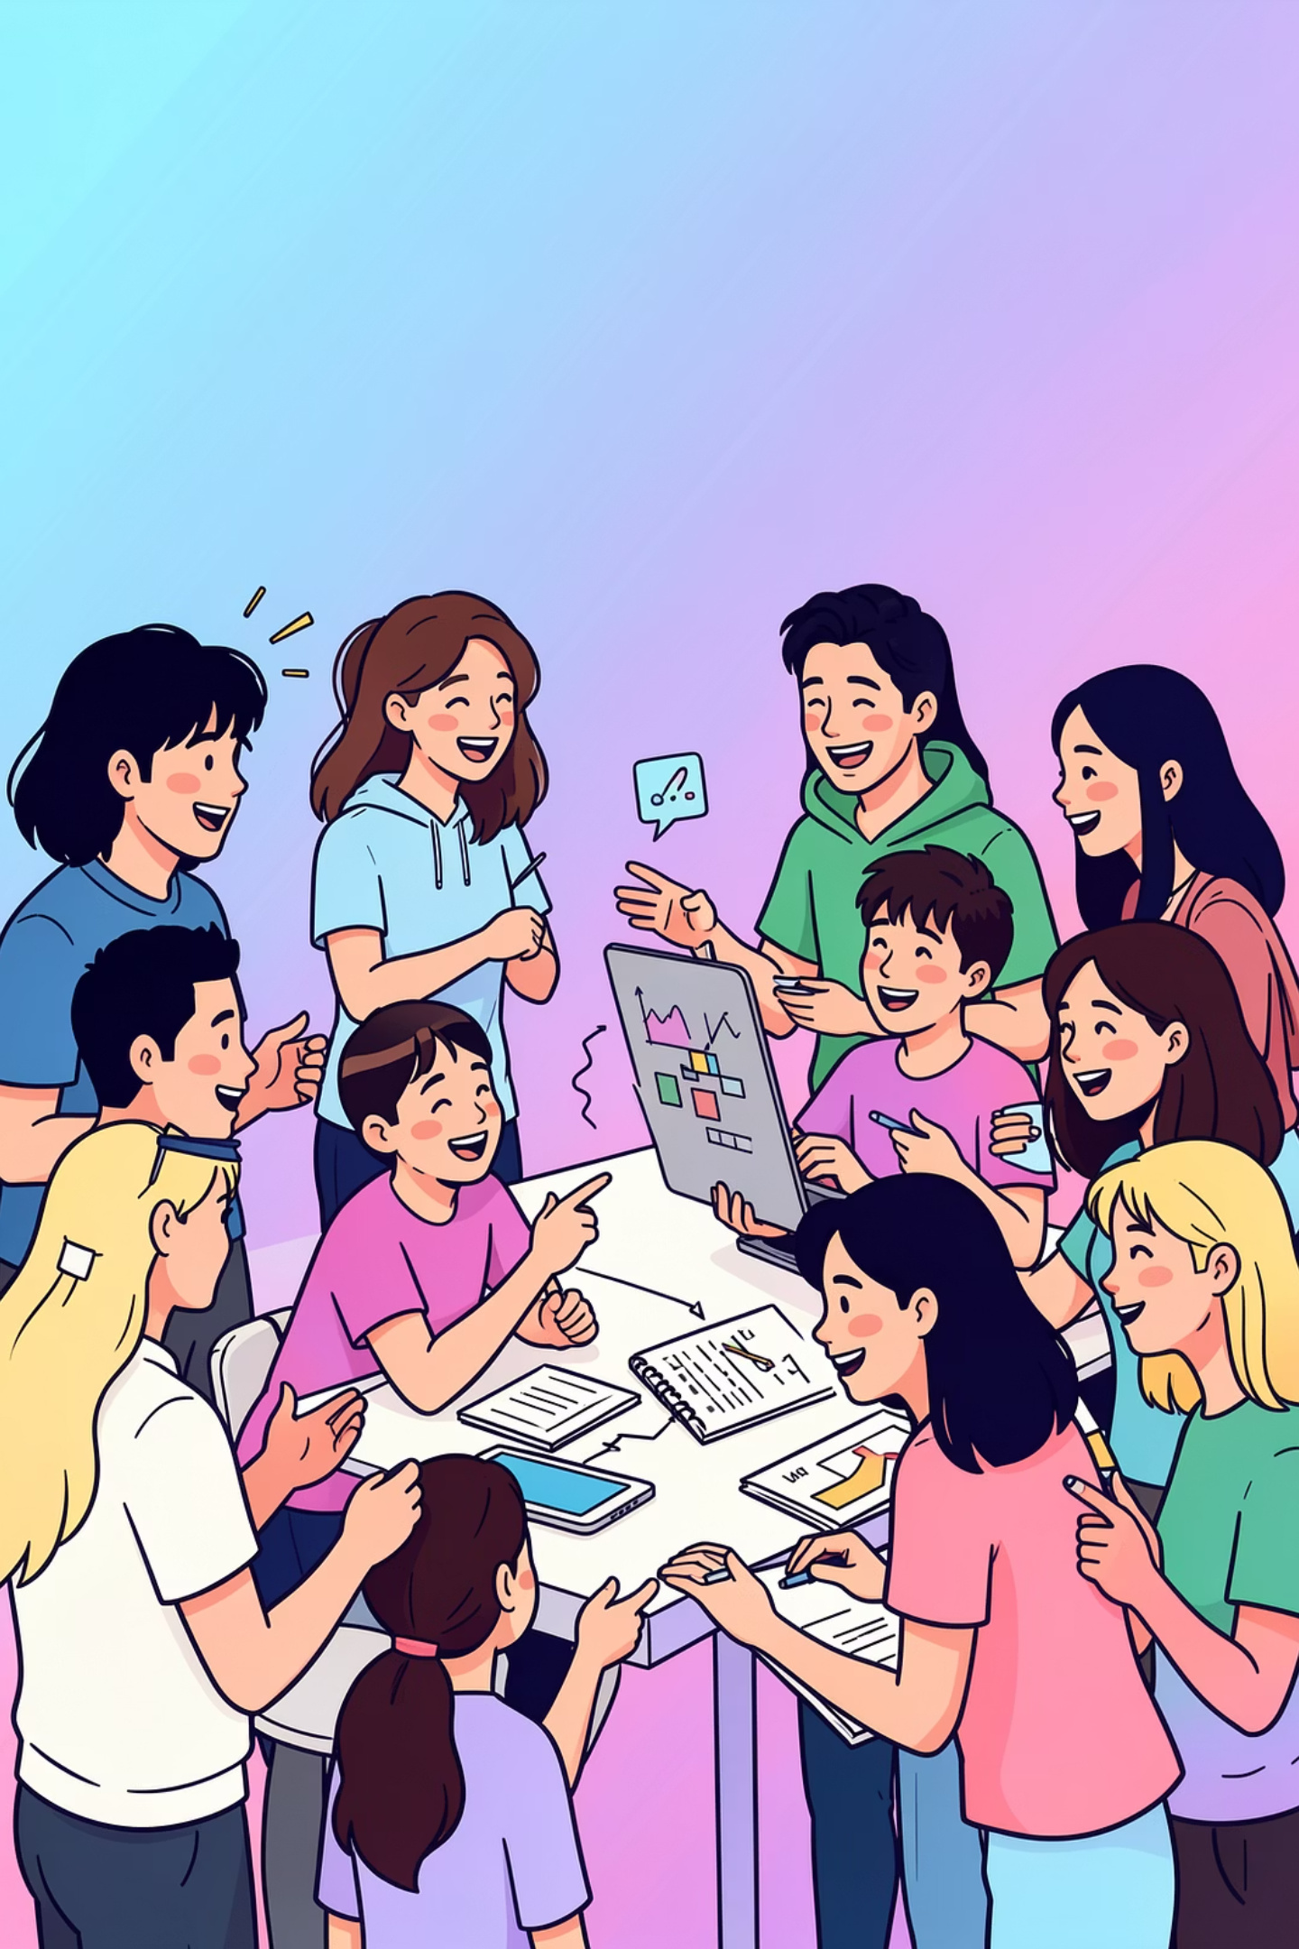
Essential AI Literacy Vocabulary
Interdisciplinary
Synthesis
Combining methods, insights, or perspectives from multiple academic fields
Combining different ideas or perspectives to create new understanding
Systems Thinking
Multi-perspective Analysis
Viewing problems as part of larger, interconnected systems rather than isolated issues
Examining a topic from multiple viewpoints or disciplinary lenses

Slide 7



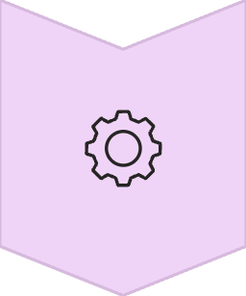
Planning Your Continued Growth
AI technology evolves rapidly. To stay current:
Experiment Regularly
Test new features and updates as platforms evolve
Follow Relevant News
Stay informed about AI developments in your field
Share Discoveries
Exchange insights with classmates and build collective knowledge
Adapt Workflows
Update your processes as tools improve
"Your AI literacy is a foundation to build on, not a final destination. Remember ethical principles as capabilities expand."

Slide 8
Activity: AI Toolkit Assessment
My Strongest AI Skill
Identify your current area of expertise
Skill to Develop Further
Celebrate strengths and embrace growth opportunities
Platform Used Most
Which tool do you reach for first?
Platform to Explore
What have you been curious about?
Top 3 Effective Prompts
Save what works and document successful patterns

Slide 9

Your Path Forward
Systems Thinking
Multi-Perspective Analysis
View problems as interconnected rather than isolated
Examine topics through different disciplinary lenses
Personal AI Toolkit
Continuous Growth
Curate tools that match your learning style and goals
Adapt as AI technology evolves and use your skills wisely
Remember: AI is a catalyst for innovation, but your critical thinking and ethical judgment guide its application

